Slide 1
VOTE ON
OCT 24
Early Voting
Oct 10-17
FRENCH QUARTER
ECONOMIC DEVELOPMENT DISTRICT
Quarter for the Quarter

Slide 2
AGENDA
Introduction Steve Pettus, Chair of FQMD
Details of EDD
& Election Ryan Berni, City of New Orleans
Comments Jeff Walls, NOPD 8th District Commander
Major Carl Saizan, Louisiana State Police
Councilmember Nadine Ramsey, District C
Questions Public

Slide 3
WHY AN ECONOMIC DEVELOPMENT DISTRICT (EDD)?
To improve the public safety of residents, workers and visitors in the French Quarter, an area that hosts approximately 9 million tourists per year, the City created an Economic Development District to enhance public safety to be financed with a small increase in sales taxes in the French Quarter, which will be paid overwhelmingly by visitors.

Slide 4
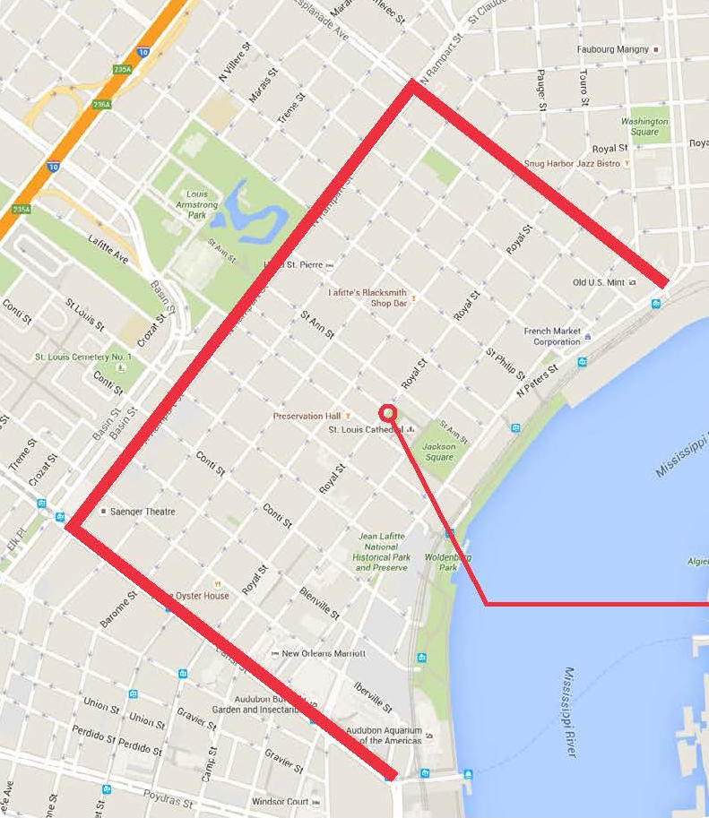
BOUNDARIES OF EDD SHARED WITH
FRENCH QUARTER MANAGEMENT DISTRICT
WHERE?
The boundaries of the EDD would match those of the French Quarter Management District, which are:
The Mississippi River;
The center line of Canal Street;
The rear property line of properties fronting on the lake side of North Rampart Street;
and the rear property line of properties fronting on the downriver side of Esplanade Avenue.
Only if approved by the voters in the EDD in an election could the additional quarter cent sales tax be levied.

Slide 5
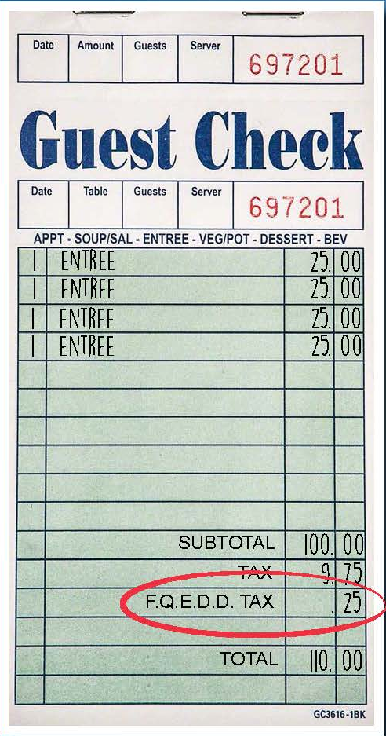
HOW MUCH?
$2 MILLION
FQEDD Tax
+
$2 MILLION
Hospitality Organizations
+
$500K
City Portion of Hotel Self Assessment
=
$4.5 MILLION for 30 STATE POLICE TROOPERS
If passed, this plan provides a minimum of 30 fulltime Louisiana State Police Troopers, which will mean at least 7 troopers at any time

Slide 6
SUPPORTING ORGANIZATIONS
Bureau of Governmental Research
French Quarter Citizens, Inc.
New Orleans Convention & Visitors Bureau
Louisiana Restaurant Association
Greater New Orleans Hotel and Lodging Association
French Quarter Business Association
French Quarter Business League
New Orleans Business Council

Slide 7
WHAT IS IT FOR?
WHAT IS IT FOR?
LOUISIANA STATE POLICE IN THE FRENCH QUARTER
  Funds generated from an additional quarter cent sales tax within the boundaries of the French Quarter Management District would be used to fund Louisiana State Police troopers
NEW ORLEANS CITY COUNCIL
  Created the EDD and sets its boundaries.
  Sits as the board of the EDD.
ELECTION ON OCTOBER 24, 2015
  Called by City Council and EDD to vote on quarter-cent sales tax proposition
  Only if approved by the voters in the EDD in an election could the additional quarter cent sales tax be levied.

Slide 8
WHAT WILL IT COST ME?
.2495%
25¢
=
SALES TAX
PER $100 PURCHASE
If you spend $5,000 per month in FQ, it will be less than $150 per year
Most security districts are about $150 per year but get less security
Most of burden on visitors

Slide 9
HOW MUCH?
APPROX. $2 MILLION PER YEAR
Will be generated by a quarter cent sales tax* increase within the FQMD boundaries to spend on enhanced public safety. These funds would be generated overwhelmingly by visitors.
*excludes hotel/motel room taxes
PLUS ANOTHER $2.5 MILLION IN TOURIST-GENERATED FUNDS
$2 MILLION: From Hospitality entities (Convention Center-$1M, CVB - $1M)
$500 K: From City portion of hotel self-assessment
$4.5 MILLION TOTAL = 30 STATE POLICE TROOPERS
If passed, this plan provides a minimum of 30 fulltime Louisiana State Police Troopers, which will mean at least 7 troopers at any time

Slide 10
FRENCH QUARTER CRIME STATISTICS
January 2015 – June 2015 compared with January 2014 – June 2014
OFFENSE | JAN-JUN 2014 | JAN-JUN 2015 | % CHANGE
Murder | 1 | 1 | 0%
Rape | 13 | 11 | -15.38%
Armed Robbery | 29 | 16 | -44.83%
Simple Robbery | 49 | 23 | -53.06%
Assault | 52 | 42 | -19.23%
Person Crime Total | 144 | 93 | -35.42%
Burglary | 28 | 11 | -60.71%
Theft | 549 | 521 | -5.10%
Auto Theft | 29 | 17 | -41.38%
Property Crime Total | 606 | 549 | -9.41%
Total Index Crimes | 750 | 642 | -14.40%

Slide 11
FREQUENTLY ASKED QUESTIONS
Will the EDD have bonding capacity?
  Technically, yes. But because the funds generated will used for recurring expenditures and so the authorizing tax ballot will not contemplate bonding capacity. It will be stated as such in the CEA.
Will there be a sunset provision?
  Yes, the sales tax will sunset after 5 years. Any renewal is subject to voter approval.
Will our property taxes be increased since the EDD authorizing language allows such?
  No. EDD law permits an entity to raise up to 5 mills and/or 2 cents sales taxes. In this instance, the ballot language would be written to permit only .2495% general sales tax. (La. R.S. 33:9038.39)
How can we guarantee that NOPD will not pull resources from the FQ if an EDD is passed?
  The ballot language will stipulate that the funds can be used only for supplemental public safety. Additionally, these provisions will be put in writing via CEA. And because these funds are directed to LSP, there will be no supplanting of NOPD officers.

Slide 12
IMPORTANT DATES
OCT 10-17, 2015 EARLY VOTING
        City Hall | 1300 Perdido St
        Algiers Courthouse | 225 Morgan St
        Chef Menteur Voting Machine Warehouse Site | 8870 Chef Menteur Hwy
        Lake Vista Community Center | 6500 Spanish Fort Blvd
OCT 20, 2015: LAST DAY TO REQUEST BALLOT FROM REGISTRAR
OCT 23, 2015 LAST DAY TO RETURN VOTED MAIL BALLOT TO REGISTRAR
  Ballots must be received by 4:30 pm (not including military and overseas citizens)
OCT 24, 2015 ELECTION DAY
        Report to assigned polling location between 7 a.m. and 8 p.m
        To find polling location: Visit nola.gov or call 504.658.8300
        When you go to the polls, be sure to have one of the following:
          A valid driver's license, Louisiana ID or some other generally recognized picture ID that contains your name and signature
          If you do not provide identification, you will be asked to fill out an affidavit provided by the commissioner.

Slide 13
ADDITIONAL
QUESTIONS?

